Slide 1

Aadhaar
The Digital Public Infrastructure of India

Slide 2
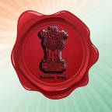


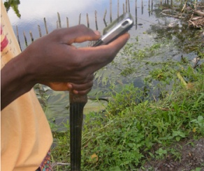


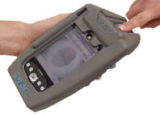
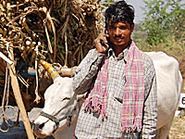
2
Aadhaar designed as a flexible, national infrastructure
Universal ID, valid all India
Interoperable platform for multiple applications
Anywhere authentication through demographics or biometrics
Only one number per person
Identity verifiable through mobile and online
6654 3212 9087
Can link to a bank a/c and cellphone

Slide 3
Aadhaar at 15 in September 2025
Aadhaar is the national ID of India (2010)
World’s largest biometric ID System serves 1.3 billion residents of India (99.9% adults)
A Digital Public Infrastructure open to all service providers Government & Private
Powers over 80 million digital transactions daily- financial & non-financial
Over 4.4 trillion Direct Benefit Transfers as social security benefits to linked Bank accounts

Slide 4
The Unique ID initiative – a need based solution
Need for AADHAAR
UIDAI mandate
To provide clean, accessible identification that can be used for claiming benefits & entitlement
Guarantee non-duplication through biometrics
Offer online authentication services that can be used across India
Enable service and applications that require a verifiable unique ID
Prevent duplication of effort and leakages existent in the current system
To provide a unique number to the residents of India
Collect basic demographic and biometric information

Slide 5
NID projects face multiple risks
Adoption
Enrolment
Political
Sustainability
Scale
Technology
Privacy & security

Slide 6
Key Strategic Design Drivers
Minimalist
Choice & Competition
Speed & Scale
Privacy and security by design
Cost
Inclusion
Outside in Design

Slide 7
Features of Aadhaar
Voluntary
Only Numbers – No Card
Random Numbers – No Intelligence
Standard Attributes – No Profiling, no transaction records
All Residents – Including Children

Slide 8
Features of Aadhaar-II
De-novo creation of database-reduced dependence & complexity
No Guarantees to Rights, Citizenship, Entitlements
Ubiquitous Authentication – anytime any where- provides platform to scale
Ensuring Security and Privacy of Information

Slide 9
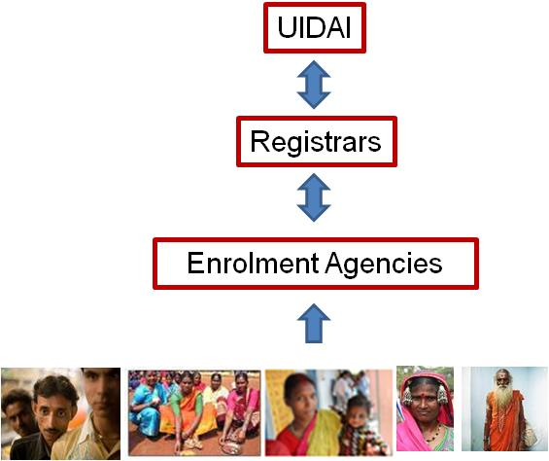
Aadhaar, a collaborative solution
Aadhaar built in partnership with Registrars
Registrars collect demographic & biometric data from residents through Enrolment Agencies/directly
UIDAI empanelled enrolment agencies used by Registrars
Aadhaar issued by the UIDAI to residents after de-duplication of data
  Scalable model to maximize reach and inclusion
  Strong Process & Technology backbone to standardize the model and drive controllership & consistency
Notes:
15 seconds slide only – just cursory
Replace the Dome

Slide 10
Enrolment

Slide 11
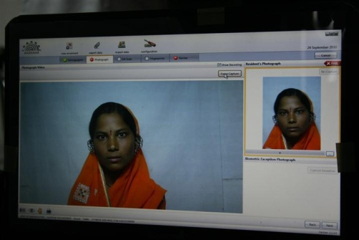

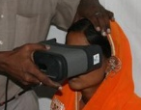
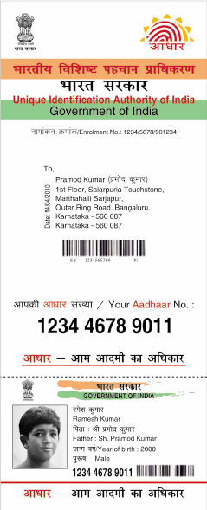
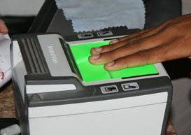
1
4 demographics + 3 biometrics = 1 unique Aadhaar number
Photo
Name
Address
Gender
Date of birth
Both
iris
1 person⬄1 number
10 finger-
prints
Notes:
Only minimal data is collected – 4 demographic details, three biometrics
DDSVP + Biometrics committee reports
The end result is a 12 digit number which can be associated with only one individual. We will see how this process works.

Slide 12
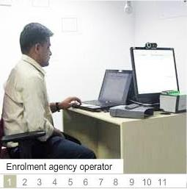
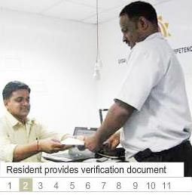
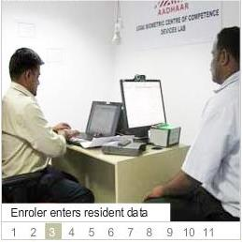
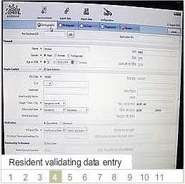
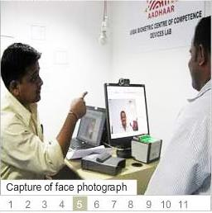
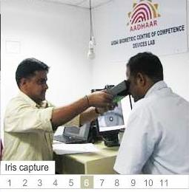
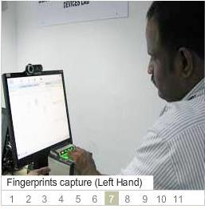
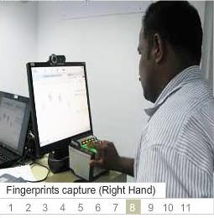
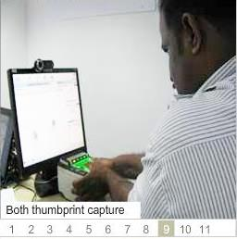
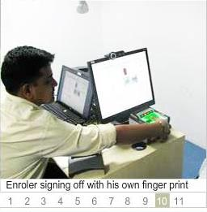
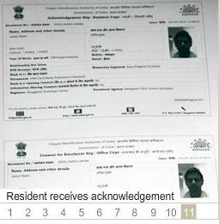
Overview of enrolment process
1

Slide 13
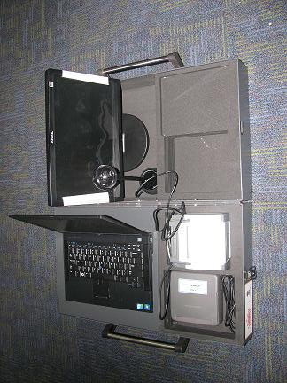
1
Enrolment kit details
Item-wise description
1
Laptop with enrolment client
1
2
2
2nd monitor for live data verification by resident
3
3
Camera for photo capture
4
Iris scanner
4
5
6
5
Fingerprint slap scanner
6
Enrolment kit box

Slide 14
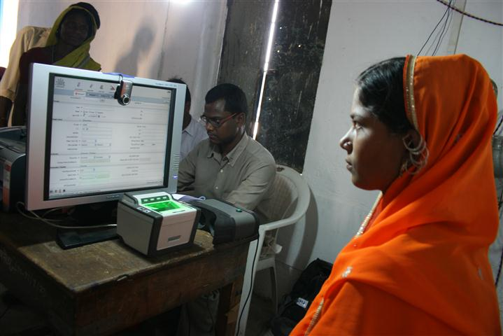
1
Review screen for resident to confirm data entered
Notes:
2.2.5 Review
An opportunity for operator and enrollee to ensure data is correct. Accountability of the operator is established by putting his own biometric signature. Only enrolled and certified operators can do this.

Slide 15
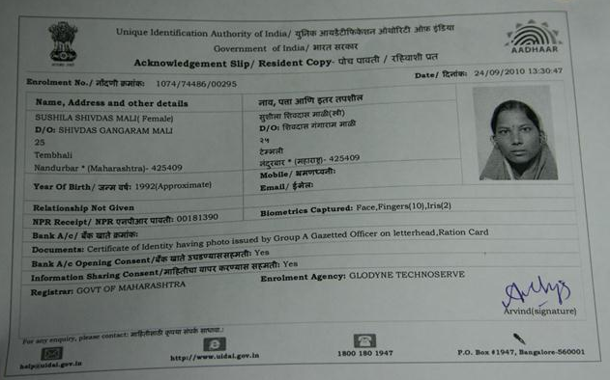
1
Enrolment receipt with all details including operator and call centre
Notes:
(show receipt of information collected) this completes the enrolment process for the resident – he can also track it by calling the contact center etc.

Slide 16
1
Design and execution optimizes quality, scale and speed with cost
Key features
Cost
H/W
S/W
Outcome
Quality
Scale
Speed
Ops
Key features
Opex model, on demand
Outcome based payment
Competition on H/W
Centralized single S/W
Price discovery of enrolment
Registrar reach and infra
Minimal data
Scalable design and tech
Platform approach
Inbuilt checks for quality
Open architecture
Open stds
Certification

Slide 17
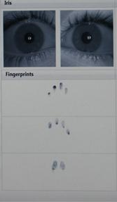



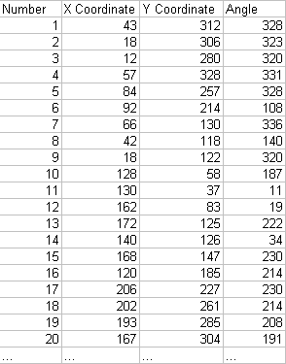
Biometrics
12 digital patterns
Uniqueness check
Aadhaar number
Notes:
The combination of the iris and the 10 fingerprints gives every individual a unique digital pattern, on which a uniqueness check is done in our database, only after which a number can be issued .

Slide 18
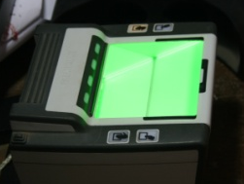


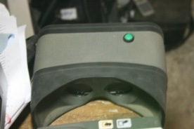
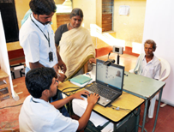


1
Same process at every Aadhaar enrolment center nationwide
Certified devices
Standardized Processes
Standardized Data Transfer
Certified devices
Standardized Processes
Standardized Data
Transfer
1
2
3
Registered Post delivery
Data Processed at CIDR
5
4
Notes:
Information collected is then encrypted at the source and uploaded to the UID server as soon as connectivity is available, if not immediately. This ensures no one can modify the data along the way. India post will then deliver this letter directly to the resident at the address provided. (present artifact).
Introducer
Family enrolment
Biometric exception mgmt
Biometric quality feedback integrated

Slide 19
1
Technology focus on inclusion and quality
Transliteration and address standardization
Introducer
Family enrolment
Biometric exception management
Duplicate screen for resident to verify data
Biometric quality feedback integrated
Encryption of data at source
Accountability of the operator
Inclusion
Quality

Slide 20
1
Aadhaar delivered at doorstep

Slide 21

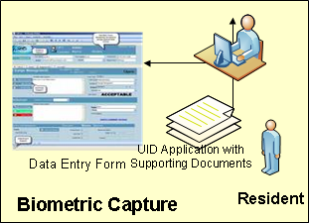

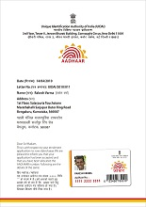

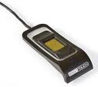

1
AADHAAR Overview
Registrar Readiness
MoU, committees etc
Process & Technology Alignment
10
1
6
CIDR
Grievance & Query Handling
Setup Enrolment Centers
Devices, hardware, software, connectivity
People, admin support, logistics etc.
3
Biometric
De-duplication
UID Assignment
Rejections identified
Prep Enrolments
Introducers
Operators, supervisors
2
Verification procedures
9
4
5
Data Updation
Certifications
Devices
Operators
Data transfer to CIDR
1
7
8
Demographic & biometric data capture
Authentication
Letter Printing & Delivery
Preparation Activities
Enrolment Activities
Ongoing Activities

Slide 22

2
Authentication – Are you who you claim to be?
Verification based on one or more of:
Who you are
Biometrics – Photo, fingerprint, iris
What you have
Paper, card, smart card, RFID card,
What you know
Demographic and other information, PIN, password, secret answer
ID Verification is a key process in most forms of public service delivery

Slide 23
Authentication

Slide 24

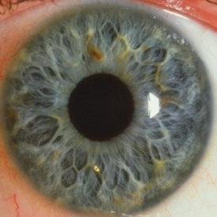
2
Aadhaar authentication supports multiple modes
YES
OR
NO
Demographic
Name, Gender, DOB, Address
PIN
Any or All

Slide 25
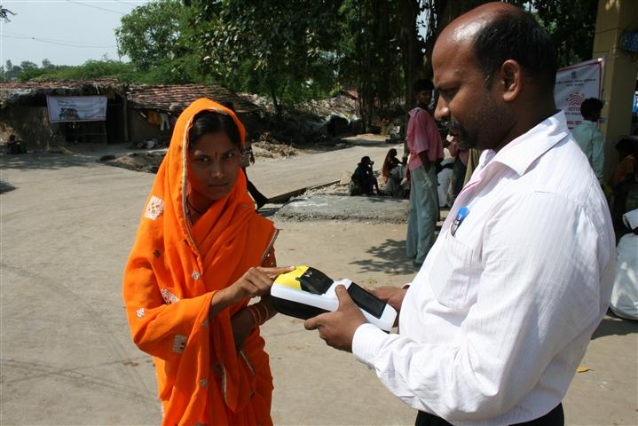
2
Fingerprint Authentication
Notes:
3.2 Demo - Positive authentication
An individual comes with nothing else other than an Aadhaar number on a piece of paper.
Aadhaar number is inputted and it asks for the resident’s fingerprint
The data packet containing the Aadhaar and biometric is then sent to our data center to perform a check and then sends back a response (Green light flashes) – all within 5 seconds!
In two easy steps, can easily prove your identity, coming from an online, central, trusted source
Only yes/no came back, no other piece of information
3.3 Demo - Imposter
To really show the power of authentication, let’s try to see if someone else can misuse my Aadhaar number in my absence (call someone from the audience) Maybe I will even give a Rs. 100 prize to the person who can impersonate me!
Enter my Aadhaar and you can place your fingerprint to see if the transaction gets executed. (Red light flashes). Thanks, I’ll keep the Rs.100 ☺

Slide 26
1
Benefits of Unique IDs
Reduces Leakages
No Fakes
No Duplicates
Provides Identities
To the marginalized
To the excluded
Breaks Silos
Enable connectivity among databases
Enable consolidation

Slide 27
1
Benefits continued
Enables Applications
Financial Inclusion
Electronic Benefits Transfer
Enhances
Security
Access to Services
Enables
Mobility in various Applications
Building up of Applications (PDS/NREGA)

Slide 28
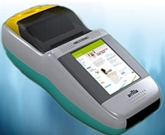
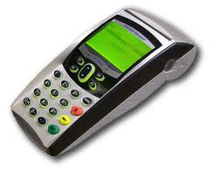
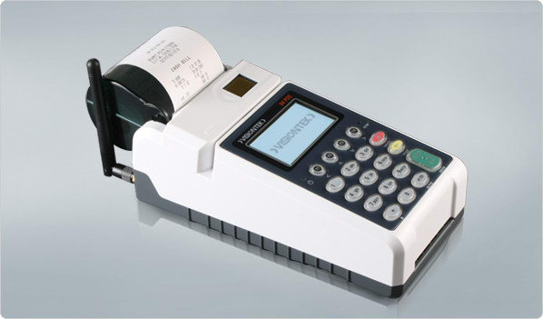
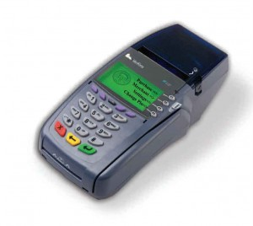
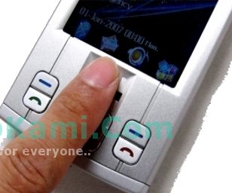

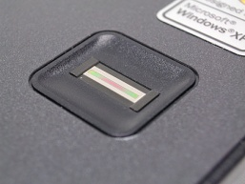
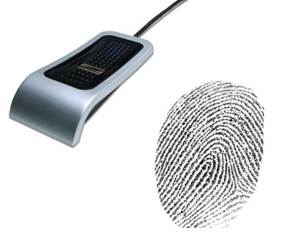
2
Any Aadhaar enabled device can be used
POS Terminals – Supporting PIN/Biometric Authentication
Mobile phone with biometric scanner
- Supports PIN/Biometric authentication
Laptop with fingerprint scanner – Supports Demographic/Biometic/Pin based auth
Notes:
This can be performed on different devices, and does not require a card to be present
It is a simple device, portable, does not require constant power and easy to use

Slide 29
Design not technology drives successful Public Systems
A project can never be better than the organization & the people behind it
Key learnings- context analysis, building coalitions, analogue before the digital, engaging a balanced mix of skill in project team & adopting an iterative & experimental approach to implementation
Technology only an enabler not a magic bullet

Slide 30
Electronic Voting & Biometric ID
India operates the largest NID/Aadhaar platform as well as the biggest Electronic Voting Machine (EVM) system in the world
India does not use Biometrics for voting
Election Commission of India (ECI) does not use biometrics to clean its electoral rolls of potential fake, duplicate & ghost entries
Since 1993 Photo ID cards issued by ECI used to identify voters but other documents also used to ensure ‘none excluded’

Slide 31
Building stakeholder confidence- a process
India took 22 years (1982-2004) to implement countrywide use of EVMs for elections
Transparency, trust and integrity are essential to building stakeholder trust
Technology is no magic bullet
Use of EVM for non experts is an opaque system compared to paper balloting system

Slide 32
The process
1993 issue of Photo ID cards by the Election Commission of India
2003 Government approved the Multipurpose National Identity Card (MNIC) of RGI
2006 Project Approved for UID’S for poor families
2009 UIDAI notified & within a year in 2010 Aadhaar launched

Slide 33
NID and election reforms
NID can automate voter registration
NID provides a single key to search electoral rolls no need to match name, region, province
NID can help clean voter rolls of fakes, duplicates and ghost entries
NID can make voting easy, anytime, anywhere
NID authentication can improve voter integrity

Slide 34
Food for thought
Purpose specific NID systems have high risk of failure & provide suboptimal returns
NID derailed elections in Kenya, Malawi, Philippines etc
E-Voting provides all the benefits of elections using technology
Biometrics only helps authentication of voter and cleaning of election rolls of fakes, ghosts, duplicates

Slide 35
Food for thought
Complex problems need simple solutions
Politics animates debates & generates controversy
Foundational ID vs functional ID
Platform approach vs standalone products
NID first followed by sequential development of applications, including elctions

Slide 36

Questions?

