Slide 1
Option NRI for 2027 National Elections: Utilizing Direct Data Capture Machines (DDCMs-PNG) to generate a new Electoral Roll for the Electoral Commission (PNGEC)
Dr. Olugbenga IGE,
Senior Research Fellow & Program Leader
E-mail: Olugbenga.Ige@pngnri.org

Slide 2
Objectives of the Study
Collaboratively develop Open-Source Voter Registration (OSVR-PNG) software with PNGEC comprising open-source technologies and biometric image software for comparing and analysing the biometric data of eligible voters for 2027 elections.
Redesign the ballot papers used for the 2022 elections to prevent multiple voting.
Integrate quasi-biometric features into the ballot papers used for the 2022 elections to prevent multiple voting.

Slide 3
Objectives of the Study
Evaluate the user-friendliness of the ballot papers used for the 2022 elections for voters.
Experiment with the redesigned ballot papers used in the 2022 elections to prevent multiple voting in the 2027 elections.
Recommend the redesigned ballot papers for use by the PNG Electoral Commission in the 2027 elections.

Slide 4
New Common Roll for 2027 Elections
Consequently, Direct Data Capture Machines (DDCMs) are recommended to the Government of Papua New Guinea (GoPNG) and PNG Electoral Commission (PNGEC) for the 2027 National Elections as they have the capacity to capture biographical information, pictures and the ten intact fingers. The DDCM comprises:
a computer system for capturing and storing voter information,
a scanner for taking the fingerprints of citizens eligible to vote,
a camera for taking pictures of eligible voters and batteries (backup) to prevent power failure,
an External Hard Disk (HDD) for backing up the data of eligible voters, and
a printer for producing the Temporary Voters Card.

Slide 5
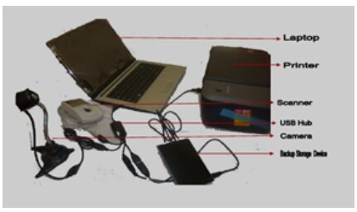
Direct Data Capture Machine (DDCMs-PNG) Option 1
The Direct Data Capture Machine can be set up in two ways:
A laptop with relevant accessories.
System Specifications: Dual core with 80-100 GB HDD and 2-4 GB RAM, external scanner, and external camera.
Figure 1: Direct Data capture machine with laptop

Slide 6
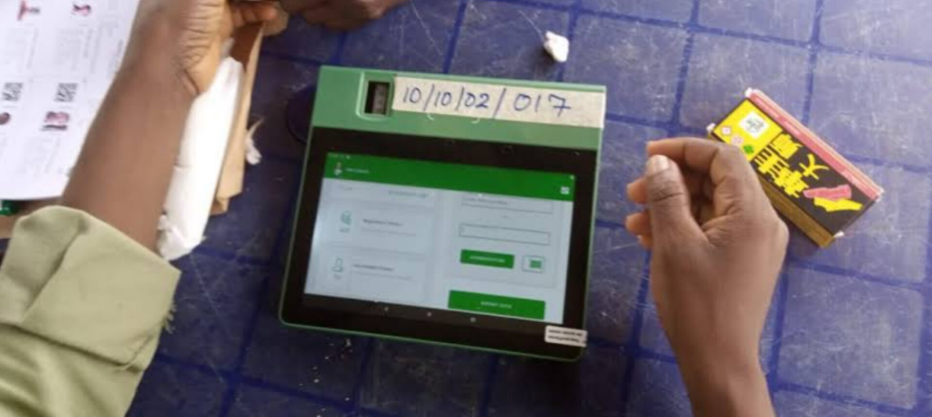

Direct Data Capture Machine (DDCMs-PNG) Option 2
A tablet with a functional scanner and camera with external 4-4-2 finger print scanner and printer.
Figure 2: Tablet with camera and scanner for data capturing System Specifications: Android 10 or later with 50GB ROM and 4 GB RAM with inbuilt camera and external 4-4-2 scanner.

Slide 7
In addition to the use of DDCMs, the NRI Research Team and Electoral Commission (EC) will collaboratively develop Open-Source Voter Registration (OSVR-PNG) software comprising open-source technologies and biometric image software for comparing and analysing the biometric data of eligible voters. The results from each voting centre across PNG will be transmitted using electronic emails or a Microsoft Excel Sheet at the conclusion of voting on the day of national elections to PNGEC in Port Moresby. The DDCMs do not need any previous or current population data to enrol citizens that are eligible to vote in the Papua New Guinea National Elections.

Slide 8
Strategies for Implementing DDCMs to Register Eligible Voters
The GoPNG must promulgate laws attaching registration of voters and voting to specific polling venues in the different provinces.
Multi-Day Teams (MDT) must be recruited and trained to operate the DDCMs for registering eligible voters.
The polling venues previously used will serve as Voter Registration Centres. For instance, East New Britain Province has 23 Local Level Governments (LLGs), an increase from 18 LLGs in 2011, 382 Wards, 534 Polling Places, and 534 Polling Booths.

Slide 9
Strategies for Implementing DDCMs to Register Eligible Voters
The 534 Polling Places will be designated as voter registration venues by virtue of the powers conferred on the EC by Section 43 of the Organic Law on National and Local-level Government Elections (Part IV. – Polling Places) and all powers it enables.
Section 43 (Part IV. – Polling Places) also allows for the appointment of new places in the creation of additional polling places and booths in highly populated regions. The EC will create new/additional Polling Places to accommodate the voter population.

Slide 10
Strategies for Implementing DDCMs to Register Eligible Voters
The Multi-Day Teams (MDT) will commence registration, with the public being notified of national voter registration by virtue of Sections 114 and 115.
The EC will engage in intensive publicity of the national voter registration schedule. At the same time, the political class, members of the PNG Parliament, officials of GoPNG, and the Civil Society will actively mobilise the electorates to register at the designated venues.

Slide 11
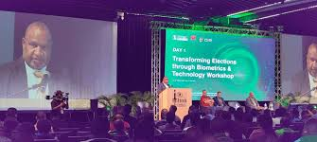
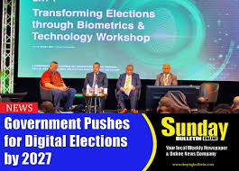
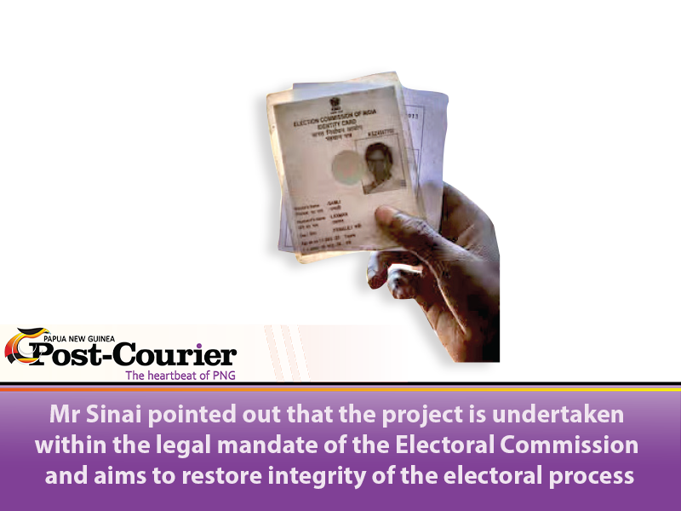
Strategies for Implementing DDCMs to Register Eligible Voters
The Multi-Day Teams (MDT) will capture the biographical data, Pictures and the intact fingerprints of citizens registering and print voter registration confirmation slips.
The registered voters will visit the registration venues on days appointed by the EC to collect the ‘Temporary Voter’s Card’ for the 2027 elections.
Permanent Voters’ Cards will be produced by the EC after the 2027 elections and used for the 2032 National Elections.

Slide 12
Redesigning Ballot Papers to Address Multiple Voting in PNG 2027 Elections
Olugbenga IGE, PhD
Senior Research Fellow & Program Leader,
National Security & International Relations Research Program
E-mail: Olugbenga.Ige@pngnri.org

Slide 13
Background to the Problem
In the report published by The National on Thursday, October 16, 2014, the National Capital District Election Manager, Terence Hetinu, commented on the problem of multiple voting that had persisted in previous elections.
“We have problems with double voting in the past where the same person can vote up to seven or eight times because we cannot properly identify the person. There are many ghost names that we do not know, whether they are real or if they are existent, and people have the tendency to vote using dead people’s names. This kind of malpractice has brought a lot of problems for the PNG Electoral Commission and the election process for PNG.”
https://www.thenational.com.pg/project-to-cut-multiple-voting/

Slide 14
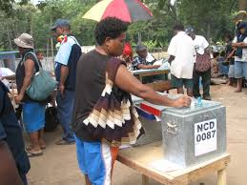
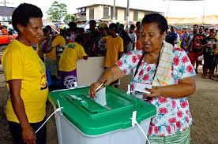
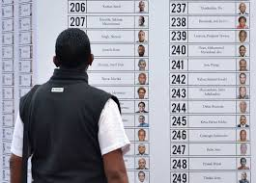
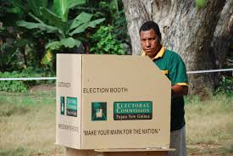
Background to the Problem
Although the voter photo rollout did occur, it did not resolve the issue of double voting and multiple voting that compromised the election process during the 2022 elections in Papua New Guinea. Based on this analysis, this research project recommends proactive strategies for redesigning election ballot papers to prevent multiple voting in Papua New Guinea's national elections.

Slide 15
The Redesigned Ballot Papers for 2027 Elections
During the checks for credibility and trustworthiness of the ballot papers redesigned for the 2027 elections, the International Reviewer who evaluated the redesigned ballot papers provided the following feedback:
The design of the ballot papers currently used for elections in Papua New Guinea appears to cater primarily to individuals with a high level of education.
The position is that a greater portion of the electorate may not possess the advanced literacy skills needed to finalize or complete the ballot papers on the day of elections. It is on this note that the current approach of writing codes on the ballot paper should be reconsidered.

Slide 16
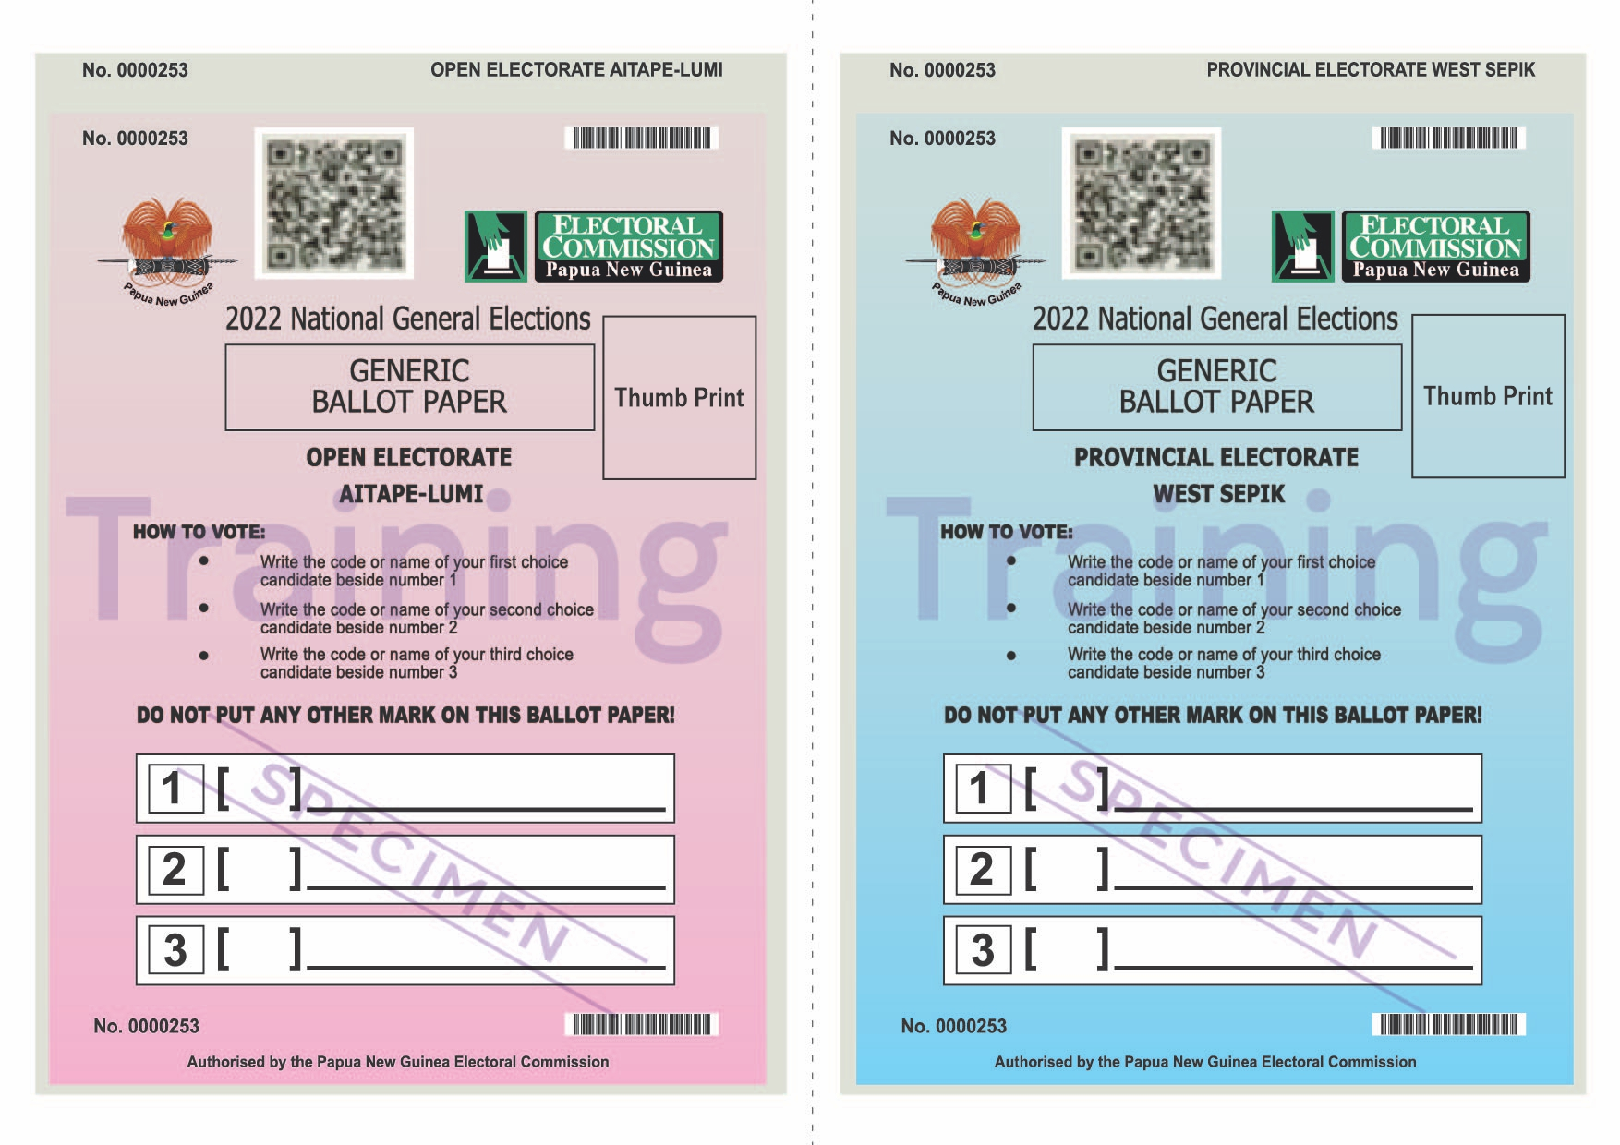
Proposed PNG Redesigned Ballot Papers

Slide 17
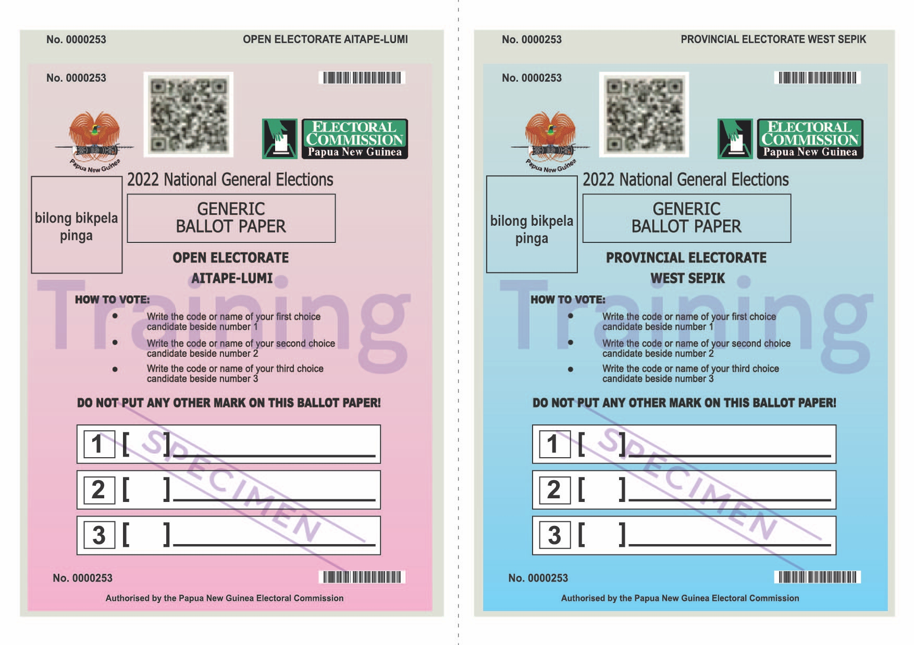
Proposed PNG Redesigned Ballot Papers

Slide 18
The Specimen Thumb Printed Ballot Papers

Slide 19
How to Vote Using the Redesigned Ballot Papers
Following the instructions provided by the PNG Electoral Commission in the 2022 elections, after completing formalities such as identifying the voters in the electoral roll as eligible voters and marking the right fingers with indelible ink to avoid multiple voting:
Write the code or name of your first-choice candidate beside number 1.
Write the code or name of your second-choice candidate beside number 2.
Write the code or name of your third-choice candidate beside number 3.

Slide 20
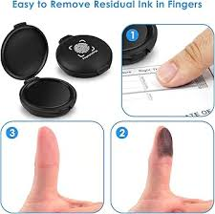
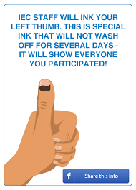
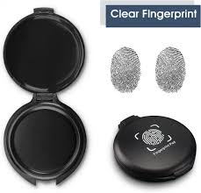
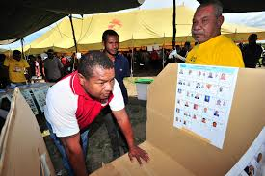
How to Vote Using the Redesigned Ballot Papers
Put your right thumb on the ink pad.
Place the right thumb with the ink in the box provided for ‘Thumb Print’ on the ballot paper.
Post your completed ballot papers in the ballot boxes.

Slide 21
Conclusion
It is recommended that planning for the registration of voters for the 2027 elections, with the use of the DDCMs, should commence from the first quarter of 2026 to the last quarter of 2026, with the National Research Institute providing active institutional support to the Electoral Commission.
Such an electoral practice in generating an electoral roll would guarantee credible elections in 2027, as data collected by other establishments for updating the electoral roll is inconsistent with cosmopolitan electoral values. The data generated by the DDCMs for the 2027 National Elections are stored locally in Papua New Guinea and not outside the country.

Slide 22
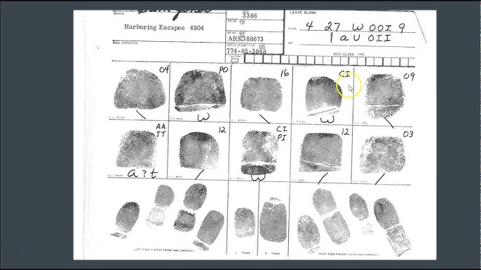
Fingerprint Classification

Slide 23
Questions
© Olugbenga IGE: PNG Elections Research

Slide 24


