Slide 1

Global Lessons in Election Technology Implementation
Sharing practical lessons from global experiences
Raul Correia - 13 Oct 2025
Notes:
Change the design

Slide 2
Digital transformation is not alien to government processes
BUT IT IS NOT MAGIC
Rethink
Adapt
Guarantee
Traditional processes that require new approaches
Technology and processes to the environment
Establish security and transparency criteria
Notes:
Digital transformation is not alien to government processes, according to the UN 94% of governments are actively planning or have implemented digital transformation initiatives. but we must remember one crucial thing: IT IS NOT MAGIC.
On the contrary, it forces us, the governing bodies and providers, to rethink, adapt, and establish new criteria for success. It forces us to rethink traditional processes and consider new approaches. It demands that we adapt technology to the unique environment where it is to be deployed. And it requires us to guarantee the process by establishing clear security and transparency criteria from the start.
This is the real path to success. So today, we are not just going to talk about technology. Over the presentation we will explore five simple lessons learned from around the world—lessons that show how we can learn from others and adapt their experiences for our own benefit.

Slide 3
1
Auditability is not an add-on, it is an essential requirement for the legitimacy of the solution
Audit and Transparency
“Trust built on proof”
BEFORE
DURING
AFTER
3rd party audit
Citizen audit
General public
Case:
Australia
Case:
Bulgaria
Case:
Kenya
Notes:
Our first principle is the most fundamental of all: Trust is Built on Proof.
When we introduce new technology into an election, we are asking millions of people to place their faith in a system they cannot see. A 'black box'. We cannot simply say, 'trust us.' We must show them. We must prove that it works, not just once, but continuously. As a demonstration I will introduce three real live cases that cover the power of auditing: Before, During, and After a deployment.
Before. This is about proactive verification, setting a set specified security and functional requirements that will guide the usage of the technology and will allow certification by 3rd parties on the solution to be implemented and the processes to be followed. A powerful example comes from New South Wales in Australia. Before deploying their Voting Centre Device, the New South Wales Electoral Commission (NSWEC) tasked independent, third-party security experts to audit the entire solution for voter lookup based on standards by the Australian Auditing and Assurance Standards Board. Their job was to try and break it, to find weakness before it could be exploited. This wasn't about hiding flaws; it was about finding and fixing them in the open. It built a foundation of technical confidence.
During. This is about citizen audits—giving voters a way to verify their own vote without requiring to technically understand how the solution works. In Bulgaria, they faced a crisis of trust. To solve it, they implemented a Voter-Verifiable Paper Audit Trail, or VVPAT (or verified paper record (VPR)). When a voter uses a machine, it prints a paper slip that they can see and confirm is correct before it's placed in a secure box. This simple paper trail provides a physical record that can be used for counts, bridging the gap between a digital vote and a tangible, verifiable action. It allows citizens to become auditors of their own democratic process.
After. This is about radical transparency, keeping records available for validation. Look at Kenya's journey. Following contentious elections, in 2022, the Independent Electoral and Boundaries Commission took a bold step. They published the raw tallying forms from over 46,000 polling stations on a public web portal. Anyone—political parties, civil society, any interested citizen—could download these forms, scrutinize them, and do their own count. This act of publishing everything demystified the process of ballot paper counting and results transmission and demonstrated confidence in their own results.
For Papua New Guinea, with its unique logistical landscape, building this trust is paramount. It means demonstrating, at every step, that the process is secure, verifiable, and open to all.

Slide 4
2
Adaptation
“One size doesn’t fit all”
A solution that does not adapt to the context is destined to be rejected.
Notes:
This leads us to our second lesson. We cannot take a solution from one country and simply drop it into another, expecting it to work. Context is King.
Every country has a unique electoral DNA—a blend of its laws, its culture, its geography, and its political history. Technology must be shaped to fit that DNA, not the other way around.
This is why in successful deployments of election and registration technology you rarely see exactly the same solution in one country versus another, take India as an example, and Brazil, and Belgium.

Slide 5

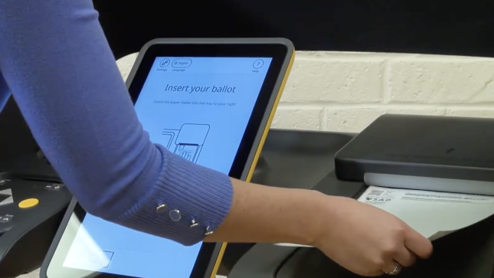
Los Angeles: Voter-Centered Election Technology
Diverse community Over 55.5% of households speak a language other than English The worst traffic in the U.S.
Notes:
Los Angeles County can be described as “a country within the United States”
An important case study is the 'Voting Solutions for All People' or VSAP system, developed in Los Angeles County, USA. LA is one of the most diverse places on earth. Instead of buying a system off the shelf, they spent nearly a decade designing their own. They held community meetings, consulted accessibility advocates, and worked with designers to build a system from the ground up. The result? A system that can be switched between over 13 different languages, that has audio ballots for the visually impaired, with modern touchscreen interface designed to be intuitive for everyone, and logistics with big vote centers with many machines that reduce the time spent in queues. It was designed for LA, by LA.
Now, let's consider Papua New Guinea. We are talking about a nation with over 800 languages. A nation with remote highland communities and coastal villages connected by sea and air. A nation with deep and diverse cultural traditions.
A 'one-size-fits-all' solution would be a recipe for failure here. Adaptation might mean designing user interfaces with symbols instead of just text. It could mean building systems with rugged hardware and long-life batteries to cope with unpredictable power supplies. It means considering how technology will be perceived and trusted within different cultural contexts. The goal is not to find the 'best' technology, but the 'right' technology for PNG.
- Population: 10 million. Most populous county in the U.S.—larger than 41 states. - Diverse community – One in three residents is a foreigner. - 55.5% of households speak a language other than English - The county includes 88 cities. Cities such as Hollywood, Beverly Hills, Malibu and Santa Monica stand out. - The worst traffic in the U.S. for 30 years.
The Los Angeles voting model put the voter at the center of the process, demonstrating that electoral technology must be thought and designed according to the particularities of the local context.
Los Angeles is the second-most populous city in the United States and the most congested, with drivers stuck for hours in traffic. To make voting more accessible and faster, Los Angeles' election system allows voters to cast their ballot at any of the nearly 900 vote centers throughout the county, regardless of where they live. This offers great flexibility and facilitates access to the electoral process.
In addition, due to the multiculturalism of Los Angeles, where 1 in 3 residents is a foreigner and 55.5% of households speak a language other than English, the voting system is designed to be inclusive. Voters can choose to view the ballot in up to 19 languages. In addition, those with disabilities have the option to listen to voting instructions, ensuring that linguistic diversity and accessibility needs are not barriers to voting.
The Voting Solution for All People (VSAP), which was officially implemented in 2020, is the result of an unprecedented collaborative research process. This model was developed with the participation of political parties, voting rights advocates, organizations that support voters with disabilities, academics, technology experts, and civil society representatives. This multidisciplinary approach was key to creating a system that is accessible and tailored to the local needs of Los Angeles.
According to a Loyola Marymount University poll, 95.4% of Los Angeles voters said voting with the VSAP system was "very easy" or "easy." In addition, more than 87% of voters described their experience as "excellent" or "very good." These numbers demonstrate the acceptance and effectiveness of the solution, which has managed to transform the voter experience, making it more accessible, faster and more efficient.

Slide 6

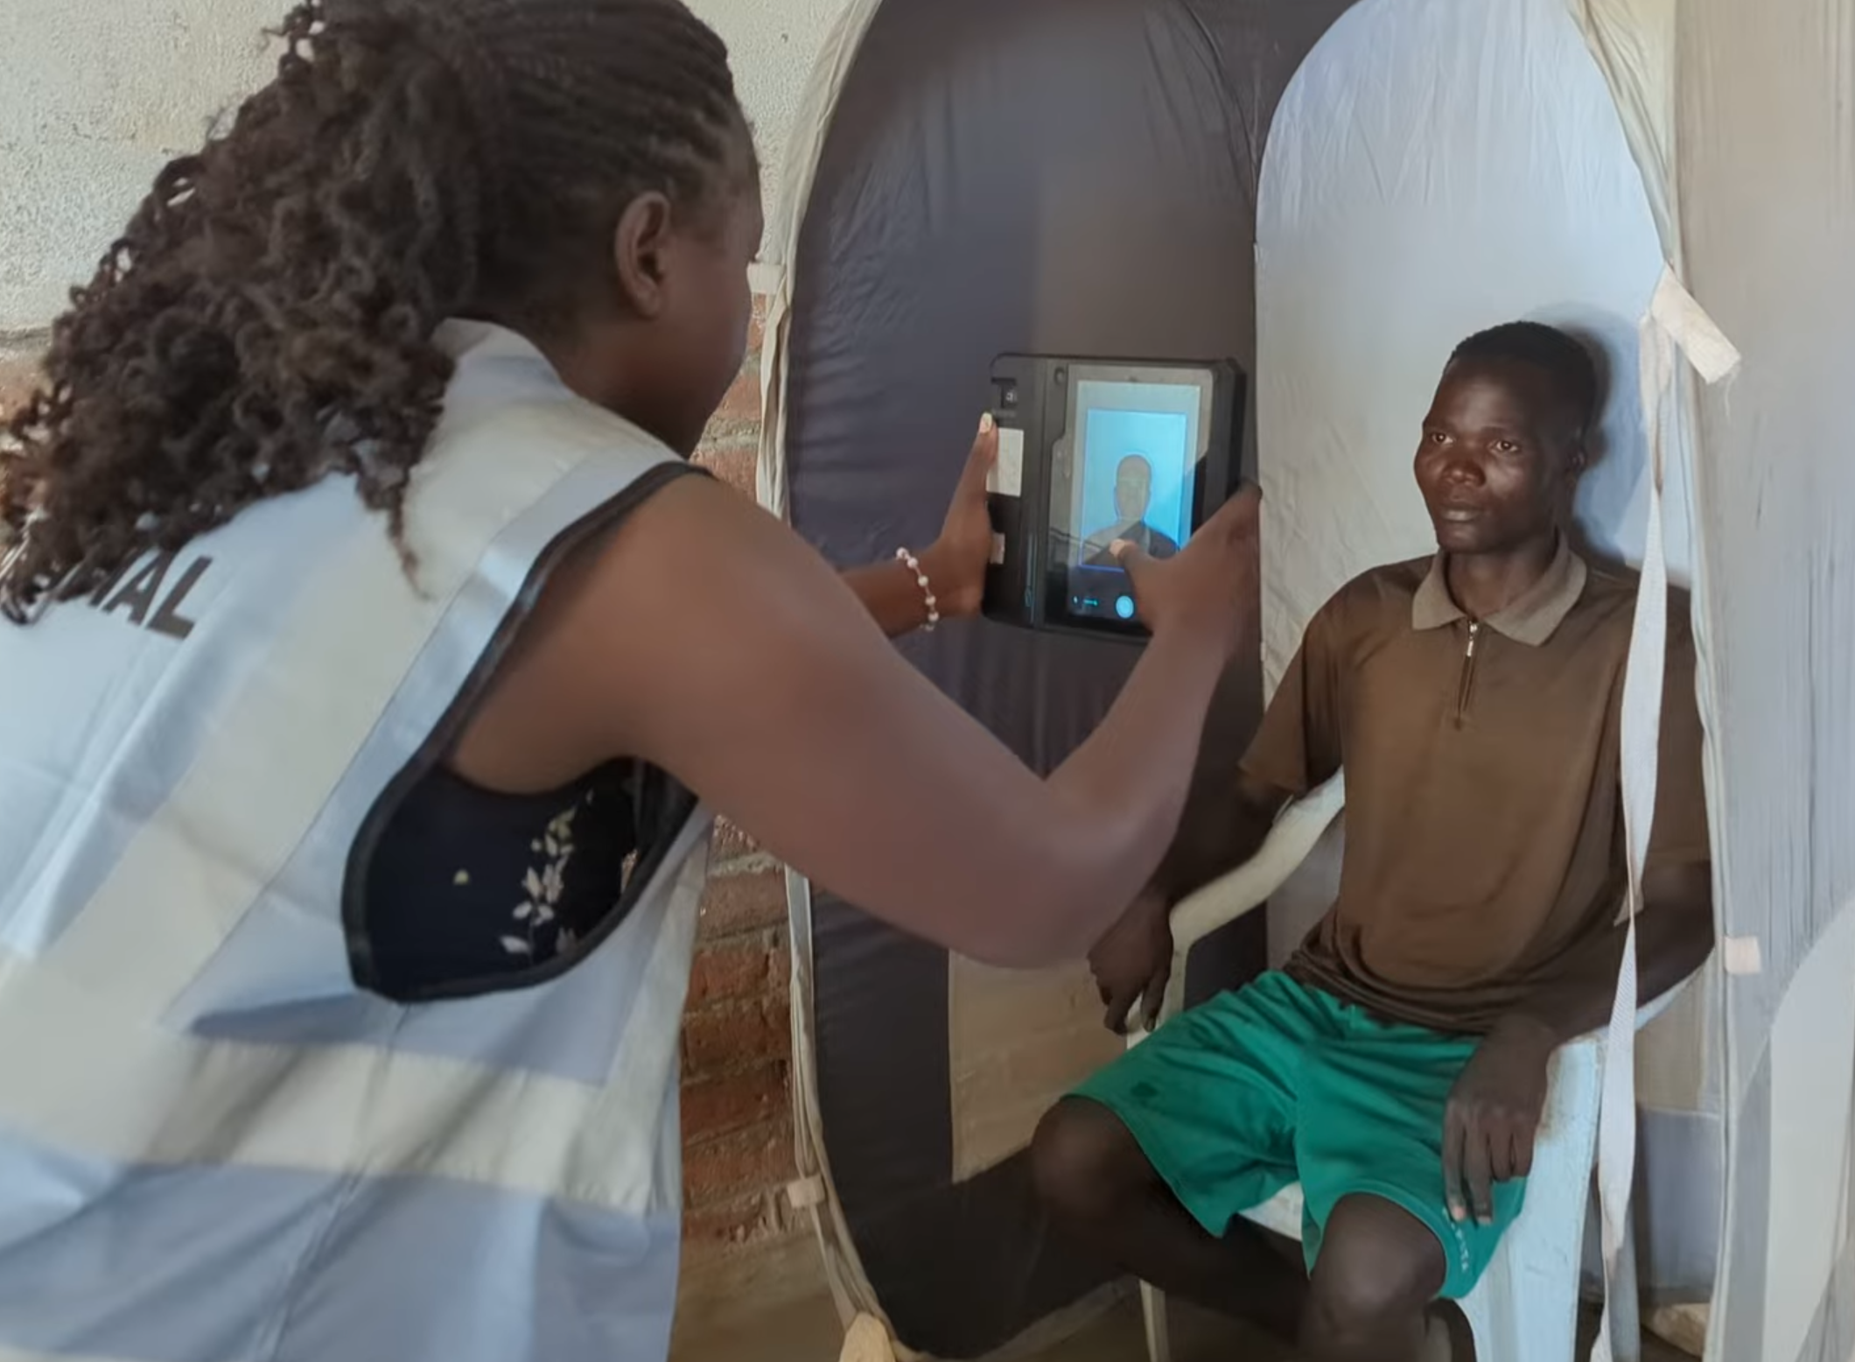

–
Voter registration field tests in Malawi
3
Field tests
“Build it, test it”
7 million people registered in 3 months
Notes:
Our third lesson is a practical one, but it is perhaps the most overlooked. The Real Test is in the Field.
You can test a system a thousand times in an air-conditioned lab and it will work perfectly. But what happens when you take it out into the real world? What about humidity, dust, rain, inconsistent power, or a bumpy ride on the back of a truck? What about the human element?
This is where field testing becomes essential. It's not just about testing if the machine turns on; it's about testing the entire human and logistical process around it.
A brilliant example of this is Malawi. In preparation for their elections, they needed to roll out a new biometric voter registration system across the country. Before the nationwide launch, they conducted extensive field test programs in different regions. These weren't just tech tests; they were full-scale dress rehearsals. They tested how long it took to set up a station, how they would manage queues, what to do when a fingerprint scanner didn't work, and how they would charge the equipment in a village with no electricity. They made software adaptations for better face image collection, and Improve logistics based on battery autonomy.
By doing this, they identified countless operational challenges. They learned, they adapted, and they refined their processes. And the result? They were able to successfully register over 7 million voters in just three months—a monumental logistical achievement made possible because they practiced in the real world. They built it, and then they truly tested it, where it mattered most. For PNG, with its formidable geography, this lesson is crucial. Field testing on Manus is different from field testing in the Highlands. Each environment will present unique challenges that can only be found by being there.

Slide 7
4
TECHNOLOGY
EXPERIENCE
Experience is as important as technology
“Know-how to succeed”
SUCCESS
It is essential to have a team that knows how to implement it under pressure, with tight deadlines and in politically sensitive contexts.
Notes:
It is not enough to have reliable and robust technology; It is equally crucial to have a skilled team that knows how to implement it under pressure, with tight deadlines and in politically sensitive contexts. When selecting a technology solution, it is not just a matter of evaluating the product itself, but of ensuring that there are experts with proven experience in the deployment and operational management of electoral processes. Excellent technology, if it falls into inexperienced hands, runs the risk of failing.
Operating an election is not the same as handing out boxes of technology. True operational experience—the knowledge gained through years of working on the ground, of what can go wrong and how to anticipate it—is what transforms a technological solution into a viable electoral solution. Deployment, logistics, training, and technical support are just as crucial as the source code itself.
It is the set of these elements that guarantees that a technology, in the context of an election, not only works, but is carried out effectively, efficiently and, above all, reliably.
“When you are researching a doctor, you do not check that they use the best scalpel, you look for the best doctor”

Slide 8
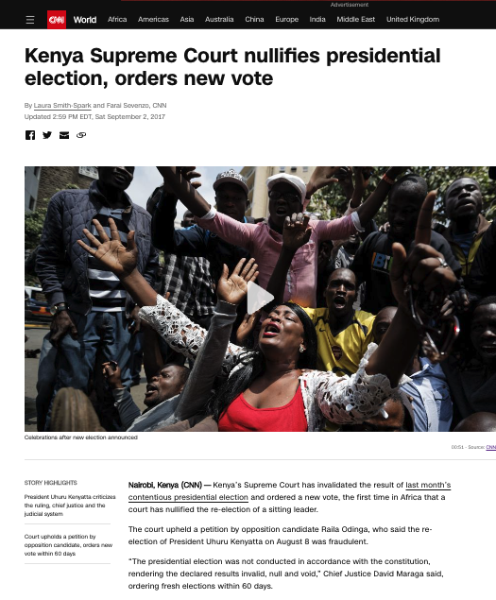
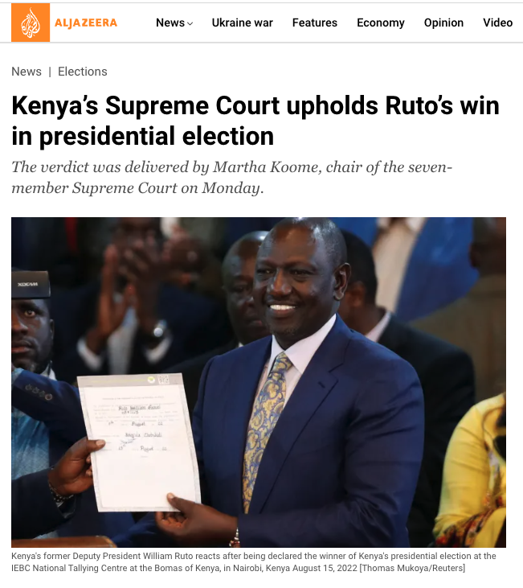
Kenya 2017 vs 2022
2017
2022
Notes:
Today I want to start by telling you a story. In 2017, Kenya's electoral authorities deployed some 40,000 devices across the country to assist in voter verification and results processing. At the close of the election, the operators had to take a photo of the minutes, to send them to the consolidation center. As the hours passed, images began to be received that were not expected. Instead of minutes, shoes, walls and many documents other than the minutes were seen. This generated a lot of mistrust. After the election, the Supreme Court annulled the election. For the 2022 elections, the authorities hired Smartmatic. We provided new devices, but also the same devices that had been used in 2017 and that belonged to the client with software specifically designed for elections. Our solution for Kenya prints a QR code on each tally sheet before it is filled out and photographed. By scanning each code before transmitting the record, the system ensured that the record was legitimate and that the image had the desired information and quality standard. 100% of the minutes transmitted could be published a few hours before the close of the election. I tell you this example because it illustrates the main message that I want to leave you today. The success of a choice is not dictated by the characteristics of a device or the specifications of a peripheral. When modernizing an election, you don't have to focus exclusively on hardware. Rather, it is necessary to approach digital transformation holistically and look for solutions (including hardware and software) designed with the environment in which electoral authorities operate in mind. The lesson is clear: in elections, the difference is not made by the most modern equipment, but by a robust, specialized solution adapted to the field. And that applies both in Kenya and in any country.
This brings us to a deeply human lesson. We can have the most advanced technology in the world, but if the team operating it are not confident, the public doesn't understand it, and no experience on similar deployment is available, it will fail.
Success is not measured by the sophistication of the devices, but by the quality of the human expertise deploying a solution. This includes well-trained staff, clear instructions for voters, and a know-how based on previous deployments.
Let's return to the case of Kenya. There is a stark contrast between their 2017 and 2022 elections. In 2017, the technology was new, there were failures with the results transmission system, staff were undertrained, and the process created widespread confusion and mistrust.
By 2022, they had learned a powerful lesson. They invested heavily in the human side of the equation. They conducted massive training programs for over 300,000 poll workers, ensuring they were comfortable with the equipment. They ran extensive voter education campaigns to explain how the system worked. The process on election day was smoother, more efficient, and better understood by everyone. The technology itself may have been an evolution, but the human experience was a revolution.
Implementing technology is not just an IT project; it is a massive change management and education project. It's about empowering poll workers to be confident problem-solvers and ensuring every voter, from a university student in Port Moresby to an elder in a remote village, feels respected and understood by the process.

Slide 9
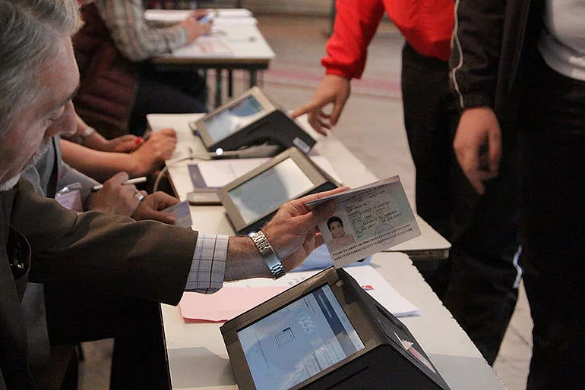
5
The key to training and knowledge transfer
Empowerment through ownership
“Independence as target”
Notes:
Our final lesson is about the future. It's about sustainability and sovereignty. Empowerment Through Ownership.
When an Electoral Management Body, or EMB, first adopts technology, it's normal to rely heavily on external vendors. But this should be a temporary phase. The ultimate goal must be to build local capacity and take ownership of the systems that run your elections.
Why is this so important? Because ownership means independence. It means you can make changes without asking a foreign company. It means you can adapt the system to new laws. It means you are building a national asset of technical expertise.
Armenia is a powerful example. They began their journey with significant support from international providers. But they had a clear vision: to eventually manage the technology themselves. Through dedicated knowledge transfer programs and capacity building, the Armenian electoral commission now has the in-house expertise to manage and deploy their own systems. They own their process, from start to finish.
Contrast this with the risk, as seen in Kenya's past, of not having full control over the voter registry. When an EMB is not the ultimate master of its own data and systems, it creates vulnerabilities and dependencies that can undermine electoral integrity.
For the PNG Electoral Commission, this is a strategic journey. It starts with partnership, but it must lead to independence. It's about investing in your own people, building a team of local experts who can become the guardians of Papua New Guinea's electoral technology future.

Slide 10
–
5 simple lessons:
Trust built on proof
One size doesn’t fit all
Build it, test it
Know-how to succeed
Independence as target
Summarising
Notes:
So, as we conclude, let's bring our blueprint together.
The path to successfully using technology in elections is not about finding the perfect device. Success isn't found in a box of new tablets or a piece of sophisticated software.
It is found in a process.
A process where Trust is Built on Proof, through radical transparency and verification.
A process where we remember that One size doesn’t fit all, ensuring solutions are tailored for the unique reality of your nation.
A process where you Build it, test it, preparing you for the challenges of the real world.
A process that recognizes you need the Know-how to succeed, focusing on training and experience.
And finally, a process with Independence as target, building a sustainable and sovereign future.
Papua New Guinea has the resilience, the ingenuity, and the spirit to forge its own path in this journey. By focusing on these principles, you can harness technology not as a foreign object, but as a powerful tool to build an even stronger, more transparent, and more inclusive democracy for all your citizens.
Thank you. Tenkyu tru. I'd be happy to answer any questions.

Slide 11

Thank you

Slide 12

–
Questions

