Slide 1
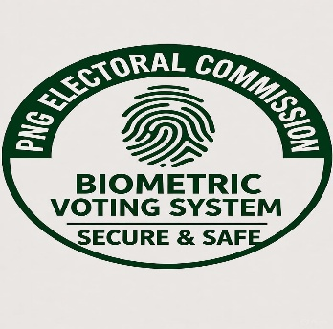


PNG Biometric Voting System
Modular, Cloud-Agnostic Solution
Presented by: Stanley Sungi – Lead Partner

Slide 2

OUTLINE
Introduction & Background
Executive Summary
Current Electoral Challenges
Solution Overview
Modular System Architecture
SDE – Data Integration & Technology Framework (API call)
High Level Roadmap
Challenges & Risks
Conclusion & Recommendation
Disclaimer

Slide 3


INTRODUCTION/BACKGROUND
Introduction
Background
  Compliance (IPA, IRC)
  Ownership (100% local)
  Team – local AWS certified engineers
  History (www.gavman.gov.pg)

Slide 4

EXECUTIVE SUMMARY
Secure Biometric Authentication
Blockchain Transparency
Multi-factor authentication using fingerprint and facial recognition ensures only eligible voters can cast ballots, eliminating ghost voting and identity fraud.
Immutable distributed ledger technology provides tamper-proof vote recording, real-time auditing, and complete transparency while preserving voter anonymity
Modular Architecture
Cloud-Agnostic Deployment
Independent modules for registration, authentication, voting, and counting enables phased implementation, easier maintenance, and targeted scalability.
Containerized architecture supports deployment on government infrastructure, AWS, Azure, or Google Cloud, ensuring vendor independence and flexibility.
Seamless API Integration
RESTful APIs Oauth 2.0 security secures with NID, Digital ID, Census Data, Ward Records, and Health Systems through the Secure Data Exchange platform, ensuring data consistency and interoperability across government systems.

Slide 5
CURRENT ELECTORAL CHALLENGES
Electoral Roll Issues
Counting Issues
Ghost vote records and fraudulent entries
Inflated or deflated ward records
Availability of diseased records
Outdated electoral records
Nil records for eligible voters
Difficulty validating and verifying voters
Human errors in manual counting
Irregular counting results
Repetitive counting processes
Lack of trust between officials and scrutineers
Early declarations during ongoing counts
Tedious paper handling processes
Voting Process Issues
System/Process-wide Issues
Repetitive voting by same individual
Using ghost names to cast votes
Block voting and intimidation
Safety concerns for citizens
Ballot box hijacking incidents
Vote buying and inducements
Electoral processes prone to manipulation
Lack of transparency in systems
Citizens validation challenges
Barriers to inclusive voting
Lack of credibility and public trust
Absence of real-time verification

Slide 6
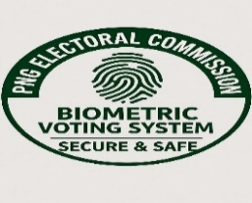
SOLUTION OVERVIEW
Our comprehensive biometric voting solution is built on three foundational pillars that work together to deliver a secure, transparent, and scalable electoral system for PNG
Unified data exchange layer connecting NID, Digital ID, Census Data, Ward Records, and Health Systems through secure RESTful APIs with Oauth 2.0 authentication. Ensures real-time data synchronization and consistency across all government databases
Biometric & Blockchain Technology
Multi-factor biometric authentication combined with immutable blockchain ledger technology provides tamper-proof vote recording, eliminates ghost voting, ensures voter anonymity, and enables complete transparency with real-time auditing capabilities
Cloud-Agnostic Modular Architecture
Containerized microservices architecture enabling deployment on government infrastructure or any cloud provider. Independent modules for registration, authentication, voting, and counting allow phased implementation and targeted scalability.
Secure Data Integration Platform
Secure
End-to-end encryption and multi-layer security
Transparent
Blockchain-based auditability and accountability
Scalable
Modular for flexible growth and adaptation

Slide 7
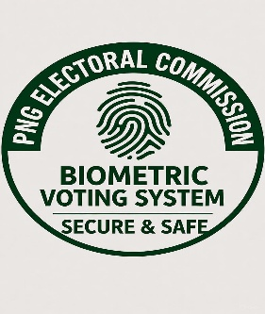
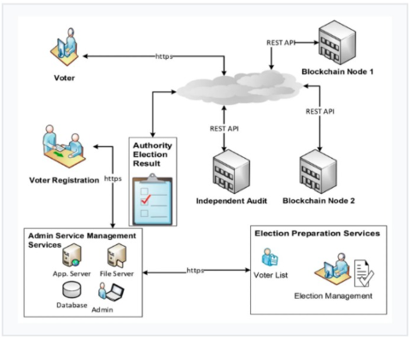
MODULAR SYSTEM ARCHITECTURE

Slide 8
MODULAR SYSTEM ARCHITECTURE
Each module operates independently, enabling phased implementation, targeted scaling, and simplified maintenance without system-wide disruption.
1. Voter Registration Module
4. Vote Counting & Tallying Module
Handle voter enrollment, eligibility verification, and biometric data capture
Automated vote decryption, counting, and real-tie results aggregation
2. Biometric Authentication Module
5. Blockchain Ledger Module
Biometric Authentication Module
Validates voter identity using fingerprint and facial recognition technology
Immutable vote recording and distributed consensus mechanism
6. Audit & Reporting
3. Vote Casting Module
Secure ballot presentation, vote encryption, and submission interface
Comprehensive logging, audit trails, and transparent reporting dashboard

Slide 9

DATA INTEGRATION
Data Sharing (REST API)
Ward Record Data
PNG NID
Education Data
Health Data
(MRN)
Digital
ID
ICA
Data
Securely sharing this data to enable an updated and more timely Biometric Voting system that is holistic and fit for the purpose and economically viable

Slide 10
SDE – DATA INTEGRATION TECHNOLOGY FRAMEWORK
PNG NID
Ward Records
System
Digital
ID
Census
Data
Security Gateway
Security
Gateway
Security Gateway
Security Gateway
Secure Data Exchange
(Composite API)
Data Governance
Cyber Security Technical
Security Infrastructure
Monitoring and OAM
Standards

Slide 11
HIGH – LEVEL ROADMAP
Stakeholder Mobilization and Project Governance
Nov 2025-Jan 2026
Development of Framework, Design and Scoping
Feb 2026-April 2026
Implementation
May 2026 to 2027 and beyond

Slide 12
CHALLENGES/RIKS
Political Interference & Project Delays
Stakeholder Participation and Management Support
Timely Budget and Funding Availability
Legislation Changes & Alignment

Slide 13
CONCLUSION
Build on Govt/Private Platform
Data is securely shared through the API calls
Alignment with GoPNG’s Digital Government Act 2022
Secure API integration
Blockchain-based transparency
Data is secured on premises or cloud (hybrid)

Slide 14
RECOMMENDATIONS
Civil & Identity Registration
- Build Registration App for self-servicing (mobile, web-based)
- Biometric capture points at Provincial HQs
- No Expiry Date
DPLGA Ward Records System (in production now)
- NSO and Census Team to support LLG Councilors to train on data entry into Mobile App
- LLG Councillors to update Birth, Death and Migration data entry on daily basis
Data Storage & Management
- All Data Collecting agencies to store data on premise and cloud for easy integration/synchronizing
Legislative Amendments required for data integration for:
- DPLG
- Immigration & Citizenship Authority
- Civil & Identity Registry (done)
- Health Registry (MRN)

Slide 15


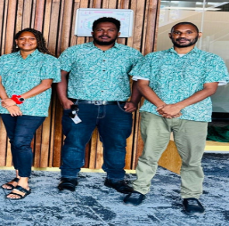
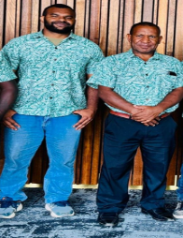
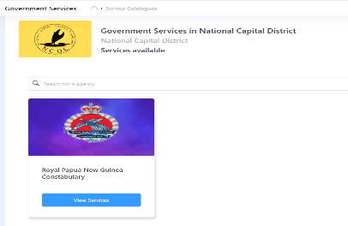






HISTORY
Operation Team
Online Police Clearance
Integration with IFMS
Gov’t Cloud Infra Built
Government Portal
Government Portal V2
Gov’t Stack Technology
Rubber Industry Board

Slide 16

DISCLAIMER STATEMENT
This presentation, outlining our bid for the proposed Biometric Voting System is based solely on public information and common knowledge. The audience, fellow vendors and government agencies are strongly restricted from using this Concept without the prior approval and knowledge of Wane Aung Technologies & Partners.

Slide 17


THE END

