Slide 1

Different Modalities of
Voter Authentication
October 13, 2025
Notes:
Change the design

Slide 2
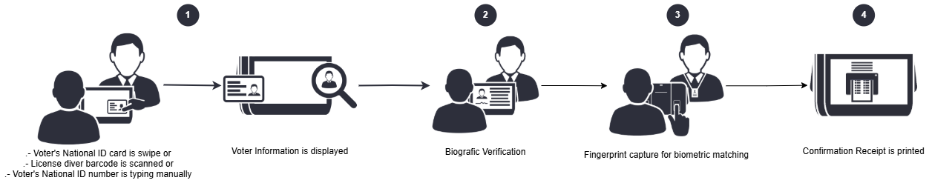
Voter Verification
Biometric Capture *
Notes:
Voter present the ID. The VIU searches and shows the voter information
The operator performs a visual validation
The voter sign with finger
The VIU prints a verificaction receipt

Slide 3
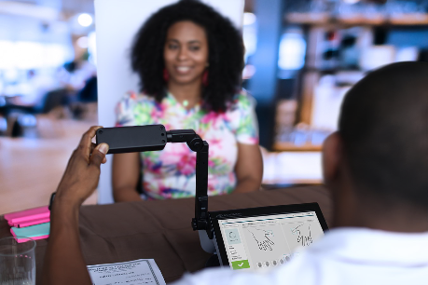

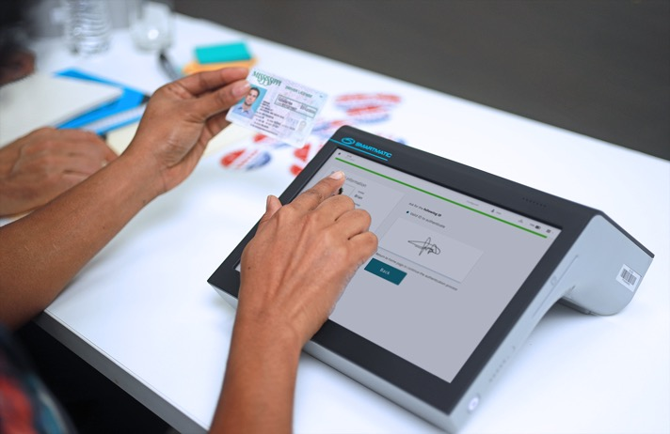
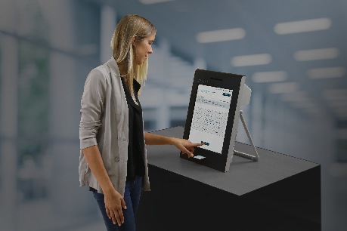
Electronic Voter Authentication
No Biometrics
Document and/or visual verification.
Capturing Fingerprint
Replace signatures
with fingerprints.
Fingerprint + Deduplication
Collect fingerprints and
analyze after election.
Fingerprint Matching
Check fingerprints against local database
in the VIU.

Slide 4

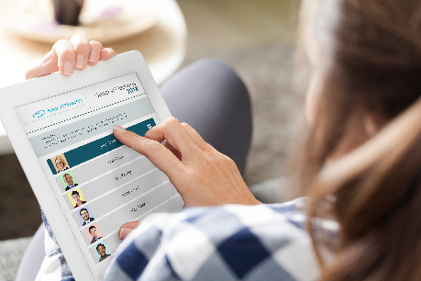
Polling Station Connectivity
Offline
Post-election aggregation of turnout statistics
Periodic Reporting
Turnout and incident reporting.
Singapore’s Model
Check identity
against database in
real-time.

Slide 5

Thank you!

