Slide 1
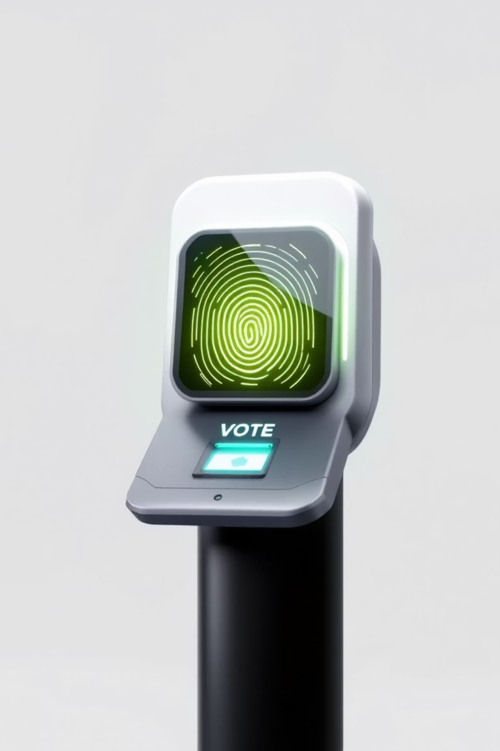
Voter Identity Reimagined – The Increasing Role of Biometrics in Elections
Andrea De Vizio – NDV International
NDV INTERNATIONAL – All rights reserved

Slide 2




The Promise of Biometrics in Elections
Biometric technology has emerged as a powerful tool to modernise electoral systems globally, offering unprecedented accuracy in voter identification and registration processes.
Global Adoption
Core Promise
Common Methods
Over 50 countries have adopted biometric voter registration to improve accuracy and prevent fraud (International IDEA, 2017)
Ensures one person, one vote by de-duplicating voter lists and verifying identities at polling stations
Fingerprints, facial recognition, and iris scans are the primary biometric technologies deployed
NDV INTERNATIONAL – All rights reserved

Slide 3

The Need of Biometric Voter Roll
Several Countries introduced biometric registration and Authentication to combat systemic issues of multiple registrations and voter impersonation.
Key Challenges
Technical glitches during registration periods
Duplicate Registrations
Voter exclusion concerns affecting marginalised communities
Removed from the electoral roll through biometric verification
Ongoing privacy debates about data storage
Different ways
Infrastructure limitations in rural areas
Full rollout of biometric voter registration system or
end-to-end Solution with e-voting
NDV INTERNATIONAL – All rights reserved

Slide 4

Security Realities: Strengths and Risks
Whilst biometric systems offer enhanced security, they introduce new risks that must be carefully managed to protect both electoral integrity and individual rights.
Impersonation Reduction
Data Protection Imperative
Biometrics significantly reduce voter impersonation, but system failures can inadvertently disenfranchise legitimate voters through false rejections
Biometric data breaches risk permanent identity theft and catastrophic loss of public trust in electoral systems
Real-World Risk Assessment
Some of critical risks include: cyberattacks, privacy vulnerabilities, and substantial implementation issues to be evaluated in each Country
NDV INTERNATIONAL – All rights reserved

Slide 5


Blockchain and Biometrics: The Next Frontier?
Looking at the future, there is a groundbreaking integration of biometrics with blockchain technology, offering a new paradigm for secure voter authentication and tamper-proof vote recording.
01
02
Transparency
Tamper-Resistance
Every transaction visible and auditable by authorised parties
Cryptographic security makes vote manipulation virtually impossible
03
Decentralisation
Distributed verification eliminates single points of failure
Remaining Challenges: Infrastructure demands, building public trust, and establishing comprehensive regulatory frameworks

Slide 6
Feasibility and Implementation Challenges Worldwide
Legal Framework Gaps
Infrastructure Barriers
Training & Timeline
Legal frameworks often lag behind technology adoption, requiring constitutional amendments and these may cause delays in implemetation
Infrastructure gaps in rural and remote areas severely limit biometric deployment capabilities
Training election officials and educating voters are essential prerequisites for successful implementation
NDV INTERNATIONAL – All rights reserved

Slide 7




Lessons Learned: Avoiding Pitfalls
Global experience with biometric systems has revealed critical success factors that separate effective implementations from failures.
Manual Fallback Systems
Always maintain manual fallback procedures to prevent disenfranchisement when biometric systems fail or malfunction
Privacy Safeguards First
Ensure robust data privacy laws and operational safeguards are in place before any rollout begins
Phased Implementation
Pilot projects and gradual deployment reduce risks and build public confidence through demonstrated success

Slide 8

The Debate: Privacy vs. Security
Balancing Competing Interests
The tension between electoral security and individual privacy rights remains one of the most contentious aspects of biometric adoption.
Cultural Resistance
Some voters resist biometric data collection due to cultural beliefs or privacy concerns
Transparency Essential
Clear communication about data use and strict access controls are vital to gain public acceptance
Global Challenge
Balancing voter rights with election integrity remains an ongoing challenge worldwide
NDV INTERNATIONAL – All rights reserved

Slide 9




Looking Ahead: The Future of Biometrics in Elections
Digital ID Integration
Increasing integration with national digital ID systems and mobile verification platforms
AI Enhancement
AI-powered biometric verification promises improved accuracy and processing speed
Global Cooperation
International collaboration needed to share best practices and establish universal standards
The convergence of emerging technologies will create new opportunities and challenges for democratic processes worldwide.

Slide 10

Conclusion: Biometrics as a Tool, Not a Panacea
Technology alone cannot guarantee electoral integrity—it must be deployed thoughtfully within robust legal, social, and institutional frameworks.
Context-Specific Implementation
Multifaceted Considerations
Biometrics can significantly enhance election integrity but require careful, context-aware deployment strategies
Security, legal, and social factors must guide adoption decisions to protect democratic principles
Continuous Evolution
Ongoing innovation and vigilance will shape the future of trustworthy elections worldwide

Slide 11


Thank you
Andrea De Vizio – NDV International
www.ndvinternational.com
andreadevizio@ndvinternational.com
NDV INTERNATIONAL – All rights reserved

